Slide 1

Vel Tech Rangarajan Dr. Sagunthala R&D Institute of Science and Technology
School of Computing
Department of Computer Science and Engineering
10211CS224 / FULL STACK APPLICATION DEVELOPMENT (JAVA)
PROJECT REVIEW : MILESTONE PROJECT – 1
Date: 03-03-2026
Relational Inventory Control & Stock Tracking System
SDG: SDG 9 – Industry, Innovation and Infrastructure
Courses Handling Faculty:
Dr.S.Hemamalini-M.E,P.hD
Presented By:
KB. NITHISH KUMAR REDDY – VTU24854 –23UECS0776

Slide 2
INTRODUCTION
Inventory Management System is a web-based application developed using Spring Boot and Maven.
The system allows users to: Securely login Add products Edit and delete products View stock details Monitor inventory dashboard
The system automatically calculates: Stock Quantity Product Status (In Stock / Low Stock / Out of Stock)
It helps organizations manage inventory efficiently and reduce manual effort.
1
2
3
4
5
6
7
8
9

Slide 3
PROBLEM STATEMENT
Traditional inventory management methods are inefficient and error-prone, lacking real-time visibility and proper organization.
Managing inventory manually leads to: Stock mismanagement Duplicate records No real-time updates Data inconsistency No centralized storage
So there is a need for: A secure login-based system Automated stock tracking Real-time inventory monitoring Structured database storage
1
2
3
4
5
6
7
8
9

Slide 4
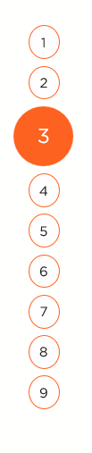
OBJECTIVE(S)
To design and develop a relational database-driven inventory control system for efficient stock tracking.
To implement real-time stock updates, reporting and secure user management.
1
2
3
4
5
6
7
8
9

Slide 5
PROPOSED SYSTEM
1
The proposed system is a Spring Boot based web application.
Features: User authentication Inventory dashboard Add Product Edit Product Delete Product with confirmation Stock status indicator
The system automatically: Tracks stock quantity Displays product status Updates inventory in real-time
2
3
4
5
6
7
8
9

Slide 6
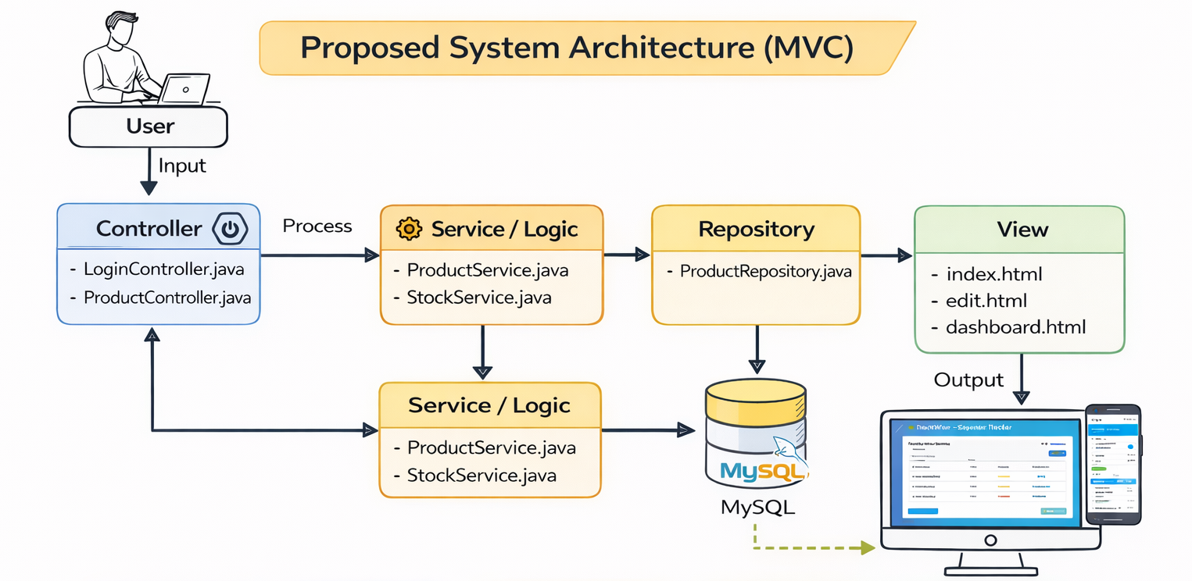
















PROPOSED SYSTEM ARCHITECTURE
1
2
3
4
5
6
7
8
9

Slide 7
PROPOSED SYSTEM ARCHITECTURE
Input:
User enters product details such as name, price, and quantity through the web interface.
Processing:
The system validates data and updates stock levels automatically.
Database:
All product records are stored and managed in a MySQL relational database.
Output:
Displays updated product list, stock status, and dashboard overview.
1
2
3
4
5
6
7
8
9

Slide 8
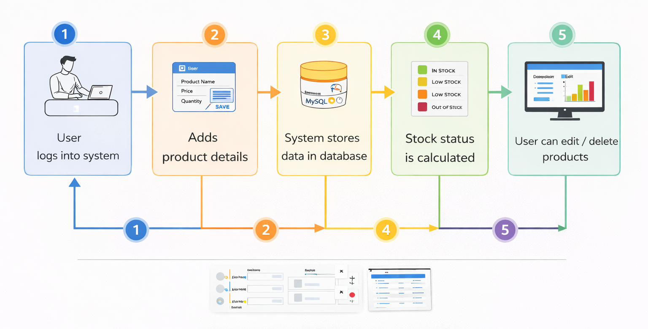
WORKFLOW
1
2
3
4
5
6
7
8
9

Slide 9
TECHNOLOGIES USED
1
Frontend: HTML, CSS
Backend: Java, Spring Boot
Database: MySQL
Tools: Eclipse IDE
Hardware/Software Requirements: Minimum 4GB RAM, JDK 17+, Web Browser
2
3
4
5
6
7
8
9

Slide 10
MODULE DESCRIPTION
Module 1 – User Authentication
Ensures secure access by allowing only authorized users to log into the system. Login page Username & password validation
Module 2 – Product Management
Enables users to efficiently manage product details through CRUD operations. Add Product Edit Product Delete Product
Module 3 – Stock Management
Monitors inventory levels and automatically updates stock status in real-time. Tracks stock quantity Displays stock status
Module 4 – Dashboard
Provides a visual summary of inventory data for easy monitoring and analysis. Displays product list Shows stock overview chart
1
2
3
4
5
6
7
8
9

Slide 11
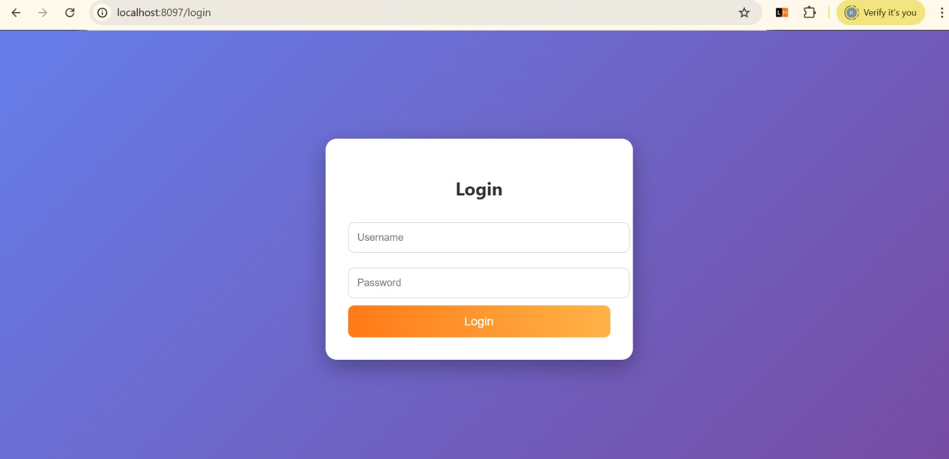
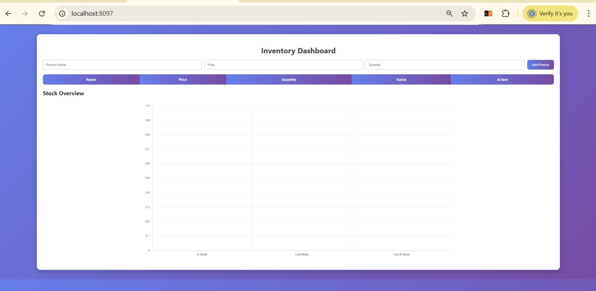
IMPLEMENTATION SCREENSHOTS
1
2
3
4
5
“Secure login page for user authentication using username and password.”
6
7
8(A)
9
“Initial dashboard view showing product table structure before data is loaded.”

Slide 12
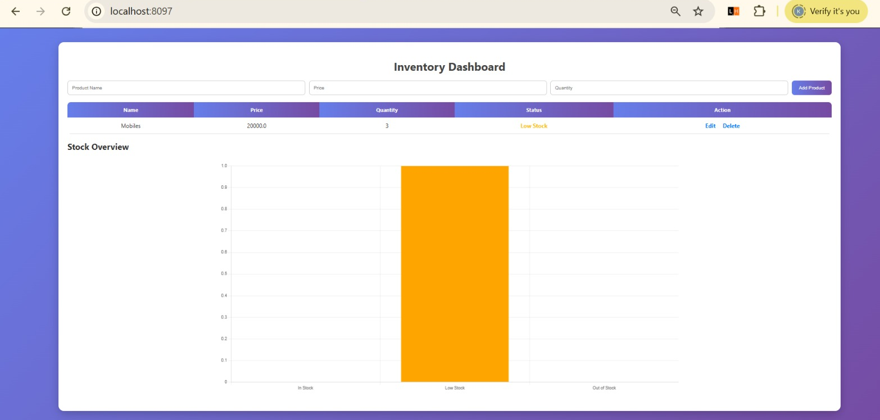
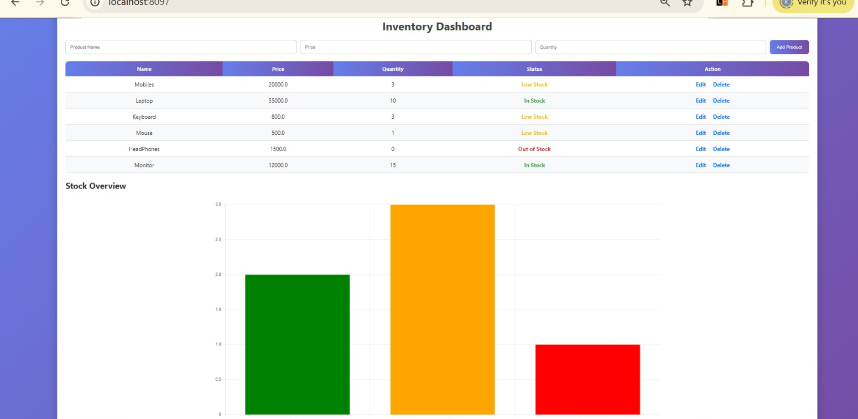
IMPLEMENTATION SCREENSHOTS
1
2
3
4
5
“Inventory dashboard integrated with stock overview chart for visual analysis of product availability.”
6
7
8
9
“Bar chart representation showing distribution of In Stock, Low Stock, and Out of Stock items.”

Slide 13
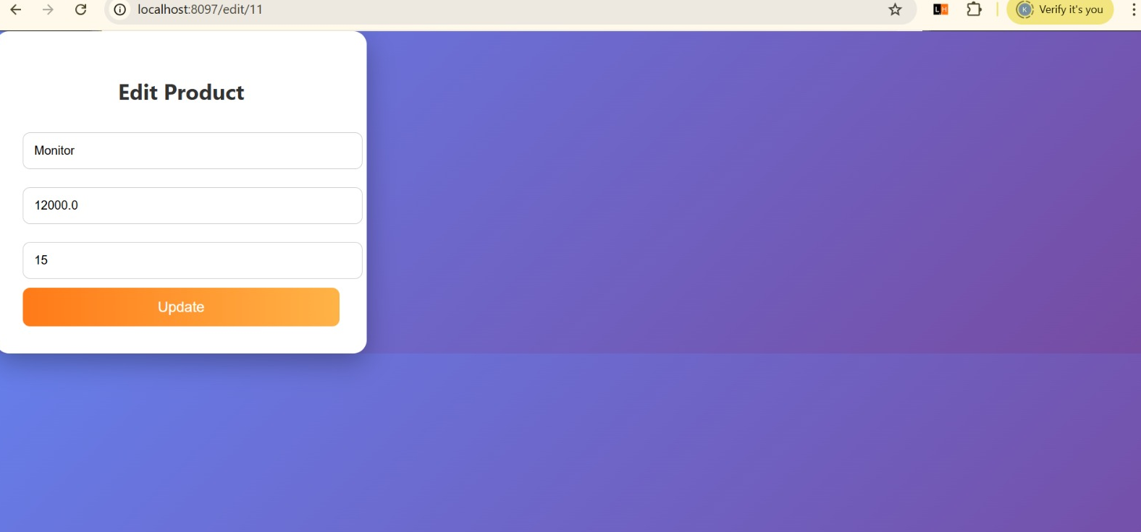
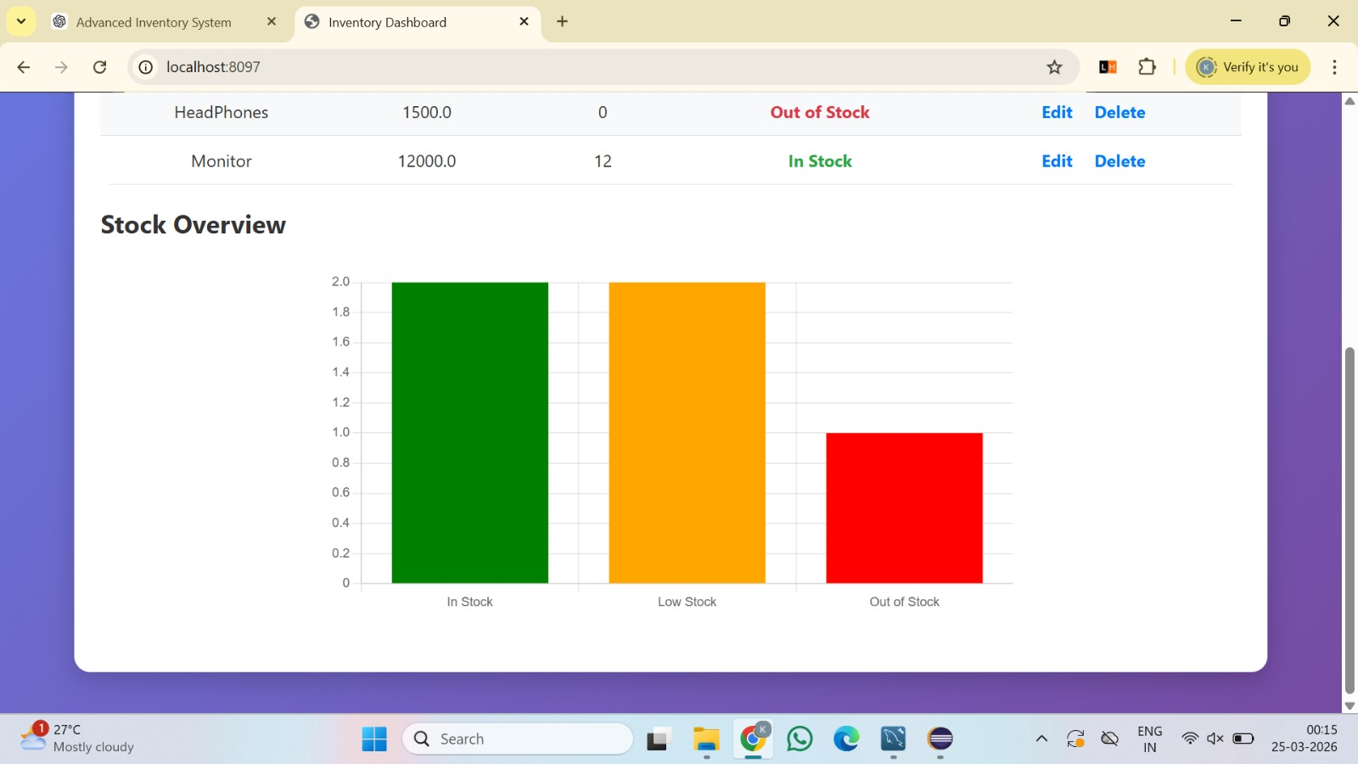
IMPLEMENTATION SCREENSHOTS
1
2
3
4
5
6
“Edit Product interface allowing users to update product name, price,
and quantity efficiently.”
7
8(C)
9
“Inventory Dashboard displaying product details including name, price, quantity, and real-time stock
status with edit and delete options.”

Slide 14
ADVANTAGES & LIMITATIONS
ADVANTAGES:
Secure login system
Real-time stock tracking
Relational database storage
CRUD operations implemented
Simple and clean UI
LIMITATIONS:
Single user system
No cloud deployment
No advanced analytics
No mobile app version
1
2
3
4
5
6
7
8
9

Slide 15
Thank you

